Slide 1
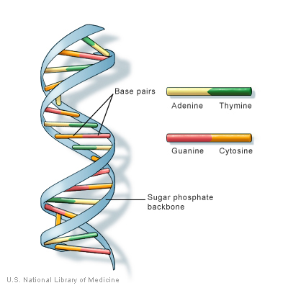
DNA Sequence Alignment

Slide 2
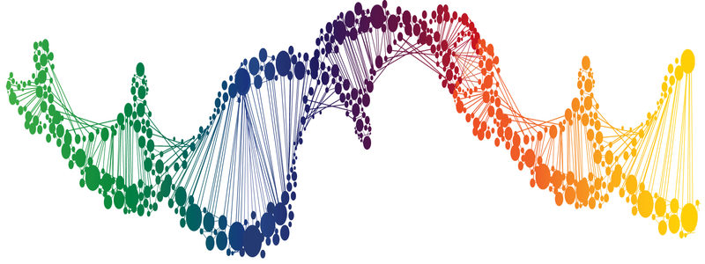
DNA Sequence alignment
Write a program to compute the optimal sequence alignment of two DNA strings
This program will introduce you to the field of computational biology in which computers are used to do research on biological systems
You will be introduced to a powerful algorithmic design paradigm known as dynamic programming

Slide 3
Sequence alignment

Slide 4
Sequence alignment
Sequence alignment is the procedure of comparing two (pair-wise) or more sequences by searching for a series of individual characters or patterns that are in the same order in the sequences
Sequence alignment arises in many fields:
Molecular biology
Inexact text matching (e.g. spell checkers; web page search)
Speech recognition

Slide 5
Sequence alignment
This is a hard example.
That is another easy example.
gap
This is a---hard ---- example.
| | ||||| | | || |||||||
That is another- easy example.
match
mismatch

Slide 6
Global alignment vs Local alignment
Global alignment is attempting to match as much of the sequence as possible (align the entire sequence)
Sequences have approximately the same length
Sequences are closely related
The tool for Global alignment is based on Needleman-Wunsch algorithm
Local alignment is to try to find the regions with highest density of matches
Finds local regions with highest level of similarity
Aligns these regions without considering the rest
The tool for local alignment is based on Smith-Waterman
Based on the basic dynamic programming algorithm

Slide 7
Global alignment vs Local alignment
Global alignment
L G P S S K Q T G K G S - S R I W D N
L N - I T K S A G K G A I M R L G D A
Local alignment
- - - - - - - T G K G - - - - - - - -
- - - - - - - A G K G - - - - - - - -

Slide 8
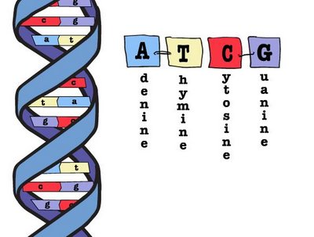
Bioinformatics

Slide 9
Bioinformatics
The alignment of biological sequences is probably the most important and most accomplished in the field of bioinformatics
Their ultimate goal is to determine the similarity between different sequences
Applications:
Gene finding
Function prediction
Genome Sequence Assembly
Database searching
Sequence divergence
Sequence assembly

Slide 10
DNA Sequence alignment
Deoxyribonucleic acid is a molecule that carries the genetic instructions used in the growth, development, functioning and reproduction
DNA was first isolated by Friedrich Miescher in 1869. Its molecular structure was identified by James Watson and Francis Crick in 1953
Notes:
DNAs are one of the four major types of macromolecules that are essential for all known forms of life.
The information in DNA is stored as a code made up of four chemical bases: adenine (A), guanine (G), cytosine (C), and thymine (T). Human DNA consists of about 3 billion bases, and more than 99 percent of those bases are the same in all people. The order, or sequence, of these bases determines the information available for building and maintaining an organism, similar to the way in which letters of the alphabet appear in a certain order to form words and sentences.

Slide 11

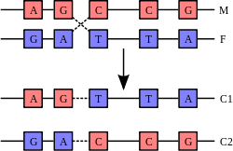
Bioinformatics
point mutations
Recombination involves the breaking and rejoining of two chromosomes (M and F) to produce two rearranged chromosomes (C1 and C2).
Notes:
DNA bases pair up with each other, A with T and C with G, to form units called base pairs. Each base is also attached to a sugar molecule and a phosphate molecule. Together, a base, sugar, and phosphate are called a nucleotide. Nucleotides are arranged in two long strands that form a spiral called a double helix. The structure of the double helix is somewhat like a ladder, with the base pairs forming the ladder’s rungs and the sugar and phosphate molecules forming the vertical sidepieces of the ladder.
An important property of DNA is that it can replicate, or make copies of itself.

Slide 12
Why Align Two Sequences
If two sequences are similar, they might share the same ancestor
If two sequences are similar, they may share the same structure, therefore similar function
In genome sequencing assembly, if two sequences have overlapping similar regions, they might be connected to represent longer sequenced region

Slide 13
Why Align Two Sequences
Sequences may have diverged from a common ancestor through various types of mutations:
substitutions (ACGA → AGGA)
insertions (ACGA → ACCGGAGA)
deletions (ACGGAGA → AGA)
the latter two will result in gaps in alignments

Slide 14
Align Biological Sequences
DNA (4)
TTGATCAC
TTTA-CAC
Protein (20 common amino acids)
RKVA--GMAKPNM
RKIAVAAASKPAV
Notes:
Proteins are large biomolecules, or macromolecules, consisting of one or more long chains of amino acid residues.
The sequence of amino acid residues in a protein is defined by the sequence of a gene, which is encoded in the genetic code. In general, the genetic code specifies 20 standard amino acids

Slide 15
DNA Sequence alignment
Align two sequences of nucleotides
DNA-sequence-1
tcctctgcctctgccatcat---caaccccaaagt
|||| ||| ||||| ||||| ||||||||||||
tcctgtgcatctgcaatcatgggcaaccccaaagt
DNA-sequence-2
DNA-sequence-1
tcctctgcctctgccatcat---caaccccaaagt
|||| ||| ||||| ||||| ||||||||||||
tcctgtgcatctgcaatcatgggcaaccccaaagt
DNA-sequence-2
Alignment

Slide 16
DNA Sequence alignment
If the two genetic sequences are similar enough, we might expect them to have similar functions
We would like a way to quantify "similar enough."

Slide 17
Implementation

Slide 18
Edit Distance Algorithm
edit distance is a way of quantifying how dissimilar two strings (e.g., words) are to one another by counting the minimum number of operations required to transform one string into the other
In information theory and computer science the Levenshtein (edit) distance (1965) is a string metric for measuring the difference between two sequences
The Levenshtein distance between two words is the minimum number of single-character edits (insertions, deletions or substitutions) required to change one word into the other
https://en.wikipedia.org/wiki/Levenshtein_distance

Slide 19
Edit Distance Algorithm
Applications:
coding theory (Hamming distance)
computational biology (bioinformatics)
natural language processing
correction of spelling mistakes
speech recognition
plagiarism detection
file revisioning
computational linguistics

Slide 20
Edit Distance Algorithm
operation | cost
insert a gap | 2
align two characters that mismatch | 1
align two characters that match | 0

Slide 21
Edit Distance Algorithm
x = “CTGTCGCTGCACG”
y = “TGCCGTG”
CTGTCGCTGCACG
-TGCCG-TG----
Cost=13
http://www.let.rug.nl/~kleiweg/lev/

Slide 22
Edit Distance Algorithm
x = “AACAGTTACC”
y = “TAAGGTCA”
x y cost
A T 1
A A 0
C A 1
A G 1
G G 0
T T 0
T C 1
A A 0
C ─ 2
C ─ 2
8
x y cost
A T 1
A A 0
C ─ 2
A A 0
G G 0
T G 1
T T 0
A ─ 2
C C 0
C A 1
7

Slide 23
Implementation
Recursive without memoization (too slow to be practical, but order N in space)
Recursive using memoization
Dynamic programming using an N×M matrix, per the Princeton problem set (aka, the Needleman-Wunsch method)
Using Hirschberg's algorithm, which is linear in space

Slide 24
A recursive solution

Slide 25
A recursive solution
Solving many edit-distance problems on smaller suffixes of the two strings
Sequence x length M and sequence y length N
Notation:
x[i] ─ character i of the string
x[i..M] ─ the suffix of x consisting of the characters x[i], x[i+1], ..., x[M-1]
opt[i][j] ─ the edit distance of x[i..M] and y[j..N]

Slide 26
A recursive solution
Example:
x = "AACAGTTACC"
y = "TAAGGTCA“
M = 10, N = 8;
x[2] = ‘C’
x[2..M] = "CAGTTACC“
y[8..N] = ∅

Slide 27
A recursive solution
Consider the first pair of characters in an optimal alignment of x[i..M] with y[j..N]
The optimal alignment matches:
x[i] up with y[j]
penalty of either 0 or 1
align x[i+1..M] with y[j+1..N] ─ suffixes of the original inputs
x[i] up with a gap
penalty of 2
need to align x[i+1..M] with y[j..N] ─ 1st input is proper suffix
y[j] up with a gap
penalty of 2
align x[i..M] with y[j+1..N] ─ 2nd input is proper suffix

Slide 28
A recursive solution
opt[i][j] = min { opt[i+1][j+1] + 0/1, opt[i+1][j] + 2, opt[i][j+1] + 2 }
Aligning an empty string with another string of length k requires inserting k gaps, for a total cost of 2k
In general we should set opt[M][j] = 2(N − j) and opt[i][N] = 2(M − i)

Slide 29
A recursive solution
Good or Bad?
If both input strings have N characters, how many recursive calls will be needed?
Number will exceed 2^{N}

Slide 30
Memoization
Memoization (memoisation) is an optimization technique used primarily to speed up computer programs by storing the results of expensive function calls and returning the cached result when the same inputs occur again

Slide 31
A recursive solution
In a top-down recursive approach we can use memoization to create a potentially large dictionary indexed by each of the subproblems that we are solving (aligned sequences)
This needs O(N²M²) space if we index each subproblem by the starting and end points of the subsequences for which an optimal alignment needs to be computed
The advantage is that we solve each subproblem at most once

Slide 32
Dynamic Programming
Dynamic programming (also known as dynamic optimization) is a method for solving a complex problem by breaking it down into a collection of simpler subproblems
In addition to finding optimal solutions to some problem, dynamic programming can also be used for counting the number of solutions
https://en.wikipedia.org/wiki/Dynamic_programming

Slide 33
Dynamic Programming
Essence of dynamic programming:
Store the sub-problem solutions for later use
Best alignment at (i,j) is the best alignment previous to (i,j) plus aligning these two
Earliest method, Needleman & Wunsch 1969
Still the best (sensitive and optimal) algorithm for pair-wise alignment

Slide 34
The Needleman-Wunsch algorithm
https://en.wikipedia.org/wiki/Needleman%E2%80%93Wunsch_algorithm

Slide 35
The Needleman-Wunsch algorithm
The Needleman-Wunsch algorithm is an example of dynamic programming, and is guaranteed to find the alignment with the maximum score
Instead of using recursion, use a nested loop that calculates opt[i][j] in the right order so that opt[i+1][j+1], opt[i+1][j], and opt[i][j+1] are all computed before we try to compute opt[i][j]

Slide 36
The Needleman-Wunsch algorithm
opt(0,0)
opt(i,j)
opt(i+1,j)
opt(i,j+1)
opt(i +1,j+1)
opt(n,m)

Slide 37
The Needleman-Wunsch algorithm
x = “MCCOHN”
y = “COHEN”
x\y |  | 0 | 1 |  | 2 | 3 | 4 | 5
 |  | C | O |  | H | E | N | −
0 | M
1 | C
2 | C
3 | O
4 | H
5 | N
6 | −

Slide 38
Traceback
To determine the choice that led to opt[i][j], we consider the three possibilities:
The optimal alignment matches
x[i] up with y[j]:
opt[i][j] = opt[i+1][j+1] if x[i] equals y[j]
opt[i][j] = opt[i+1][j+1] + 1 otherwise
x[i] up with a gap:
opt[i][j] = opt[i+1][j] + 2
y[j] up with a gap:
opt[i][j] = opt[i][j+1] + 2

Slide 39
Hirschberg's algorithm

Slide 40
Hirschberg's algorithm
Hirschberg's algorithm is a divide and conquer version of the Needleman–Wunsch algorithm
The Hirschberg algorithm can be derived from the Needleman-Wunsch algorithm by observing that:
one can compute the optimal alignment score by only storing the current and previous row of the Needleman-Wunsch score matrix;
if (Z,W)=NW (X,Y) is the optimal alignment of (X,Y), and X=X^{l} + X^{r} is an arbitrary partition of X, there exists a partition Y^{l} + Y^{r} of Y such that NW(X,Y)= NW(X^{l},Y^{l}) + NW(X^{r},Y^{r})

Slide 41
Hirschberg's algorithm
(AGTACGCA, TATGC)
/ \
(AGTA, TA) (CGCA, TGC)
/ \ / \
(AG, ) (TA, TA) (CG, TG) (CA, C)
/ \ / \
(T, T) (A, A) (C, T) (G, G)
http://users.monash.edu/~lloyd/tildeAlgDS/Dynamic/Hirsch/

